Slide 1



Information Communication Technology
(CSC101)
Lecture 3
Instructor: Mariam Fiaz
email: mariamsherwani434@gmail.com

Slide 2


Reference Books:
1. Computer Science Illuminated – Nell Dale & John Lewis, Jones & Bartlett Learning, LLC, 2020 (Read Chapter 2)
  2. Understanding Computers: Today and Tomorrow, Comprehensive – Deborah Morley & Charles S. Parker, Cengage Learning, 2017 (Read Chapters 2)

Slide 3
Contents:
  Understand different number systems
  Learn Binary, Octal, Decimal, and Hexadecimal
  Convert numbers between bases
  Perform addition and subtraction in different bases
  Apply number systems in computing

Slide 4
Introduction to Number System:
Basic Defination
A numbering system is a method used to represent numbers using symbols and positional values. Common number systems used in computing include Decimal (Base 10), Binary (Base 2), Octal (Base 8), and Hexadecimal (Base 16). Each system has a base that determines the number of symbols and the positional weight of digits.

Slide 5
What is a Number System?
A method to represent numbers using symbols.
Each system has a base.
Base = total number of digits used
Example:
Decimal → Base 10
Binary → Base 2
Octal → Base 8
Hexa → Base 16

Slide 6
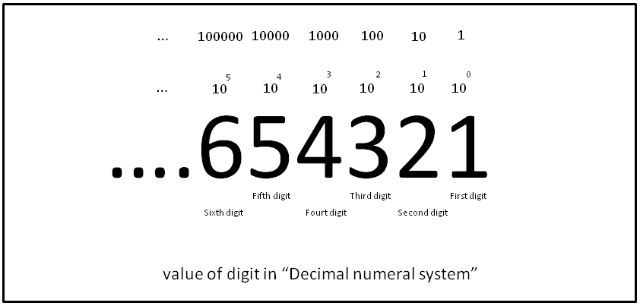
1. Decimal Number System (Base 10)
  Digits: 0–9
  Positional values: powers of 10
  Example:
  345 = 3×10² + 4×10¹ + 5×10⁰
  Most common system used by humans

Slide 7
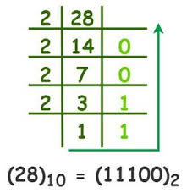
2. Binary Number System (Base 2)
  Digits: 0 and 1
  Used internally by computers
  Positional values: powers of 2
  Example:
  1011₂ = 1×2³ + 0×2² + 1×2¹ + 1×2⁰s

Slide 8
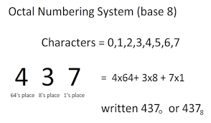
3. Octal Number System (Base 8)
  Digits: 0–7
  Shortcut representation of binary
  Each octal digit = 3 binary bits
  Example:
  17₈

Slide 9
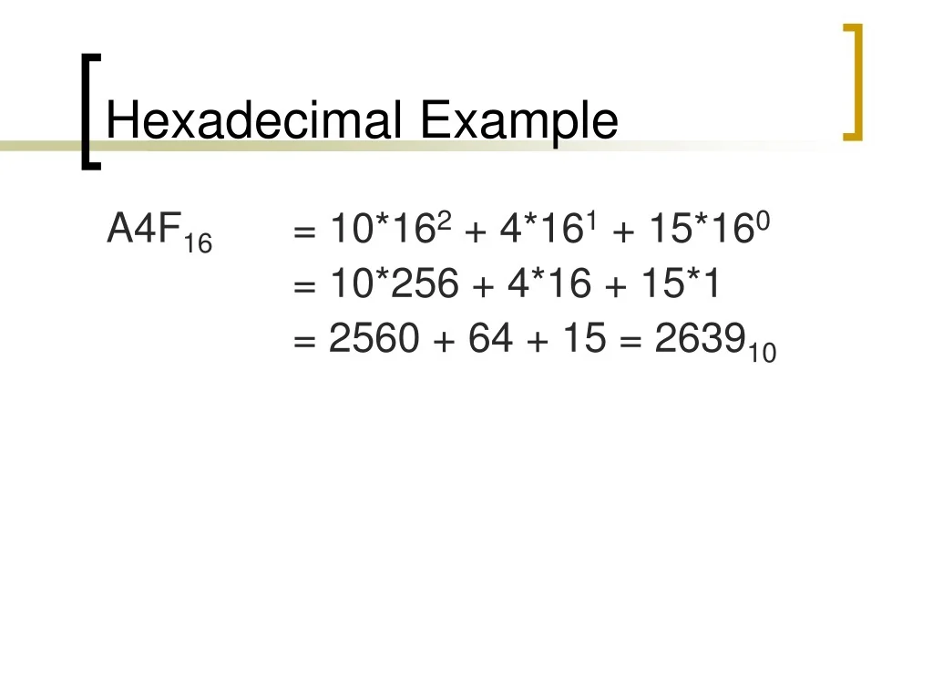
4. Hexadecimal Number System (Base 16)
  Digits: 0–9 and A–F
  A=10, B=11, C=12, D=13, E=14, F=15
  Each hex digit = 4 binary bits
  Widely used in programming & memory addressing

Slide 10
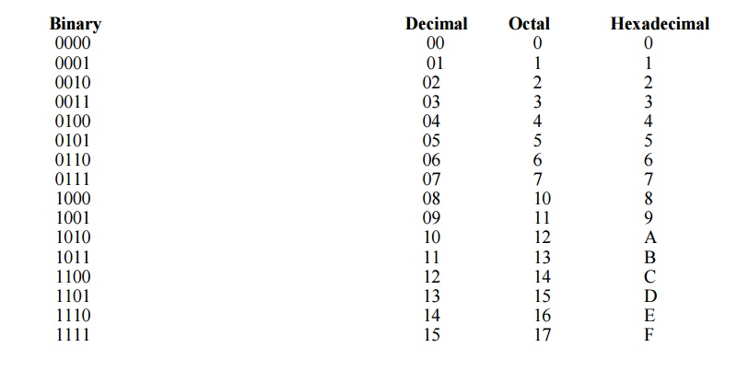

Slide 11
Number System Conversions
Overview:
Decimal ↔ Binary
Decimal ↔ Octal
Decimal ↔ Hexadecimal
Binary ↔ Decimal
Binary ↔ Octal
Binary ↔ Hexadecimal

Slide 12
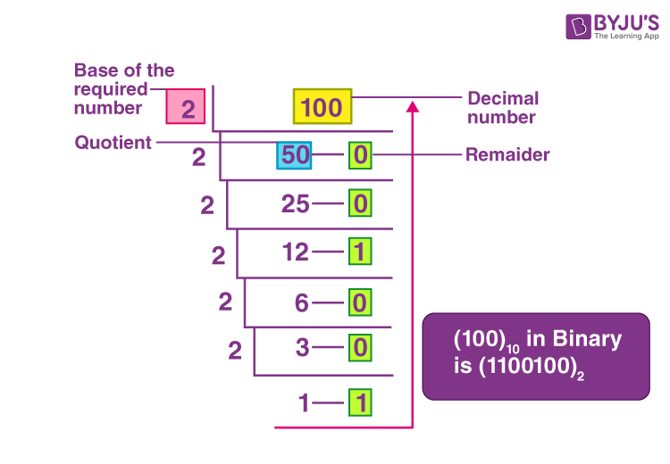
1. Decimal to Binary Conversion
  Steps:
  Divide number by 2
  Record remainder
  Continue until quotient = 0
  Read remainders bottom to top
  Example:
  25₁₀ → 11001₂

Slide 13
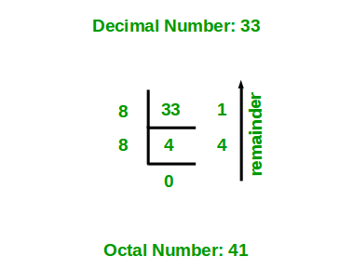
2. Decimal to Octal Conversion
  Steps:
  Divide number by 8
  Record remainder
  Continue until quotient = 0
  Read remainders bottom to top
  Example:
  65₁₀ → 101₈
  Student Activity:
  Convert 83₁₀ → Octal

Slide 14
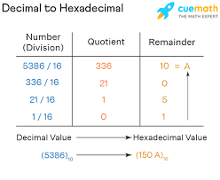
3. Decimal to Hexadecimal Conversion
  Steps:
  Divide number by 16
  Record remainder
  Continue until quotient = 0
  Convert values 10–15 into A–F
  Example:
  254₁₀ → FE₁₆
  Student Activity:
  Convert 125₁₀ → Hexadecimal

Slide 15
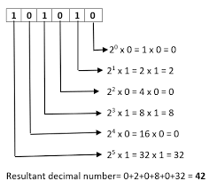
4. Binary to Decimal Conversion
  Steps:
  Write positional values
  Multiply digits with powers of 2
  Add results
  Example:
  1011₂ = 11₁₀

Slide 16
5. Binary to Octal Conversion
  Steps:
  Group binary digits into sets of 3
  Convert each group to octal
  Example:
  111010₂ → 72₈

Slide 17
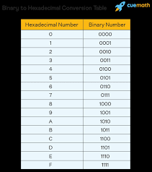
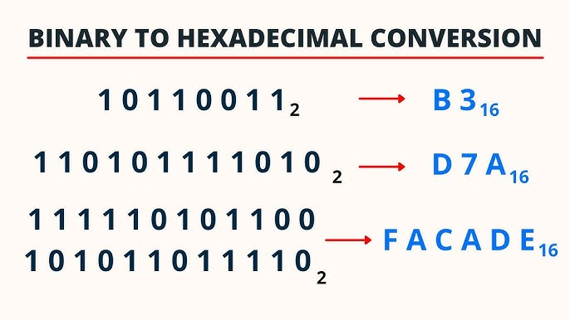
6. Binary to Hexadecimal Conversion
  Steps:
  Group binary digits into sets of 4
  Convert each group to hex
  Example:
  11111111₂ → FF₁₆

Slide 18
Number System Arithmetic
Overview:
Decimal Addition
Binary Addition
Octal Addition
Hexadecimal Addition
Decimal Subtraction
Binary Subtraction
Octal Substraction
Hexadecimal Subtraction

Slide 19
1. Decimal Addition
  Rules:
  Base 10 carry system
  Example: 456 + 234 = 690

Slide 20
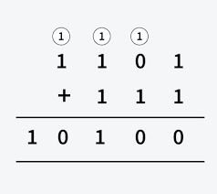
2. Binary Addition
  Rules:
  0+0=0
  0+1=1
  1+0=1
  1+1=0 (with 1 carry over)
  Example: 1011 + 0101 =10000

Slide 21
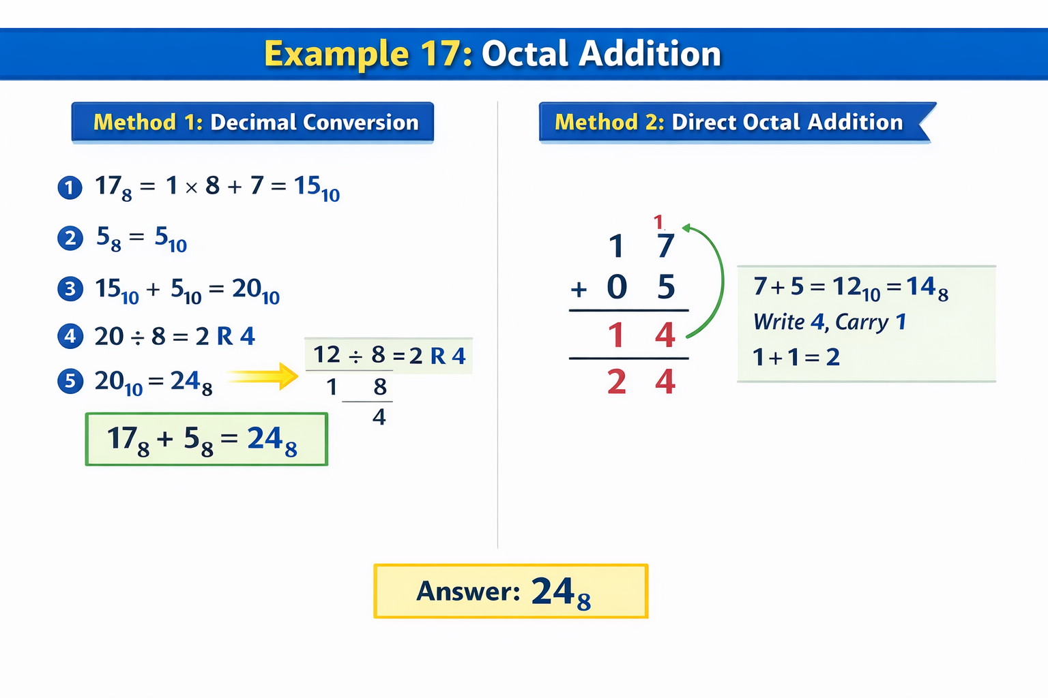
3. Octal Addition
  Rules:
  Base 8 arithmetic
  Carry when sum ≥ 8
  Example:
  17₈ + 5₈ = 24₈

Slide 22
4. Hexadecimal Addition
  Rules:
  Base 16 arithmetic
  Digits range from 0–9 and A–F
  A=10, B=11, C=12, D=13, E=14, F=15
  Carry occurs when sum ≥ 16
  If result exceeds F, convert to decimal, divide by 16, carry forward.
  Example:
  A₁₆ + 5₁₆ = F₁₆

Slide 23
5. Decimal Subtraction
  Rules:
  Borrow method
  Example:
  523 − 248 = 275

Slide 24
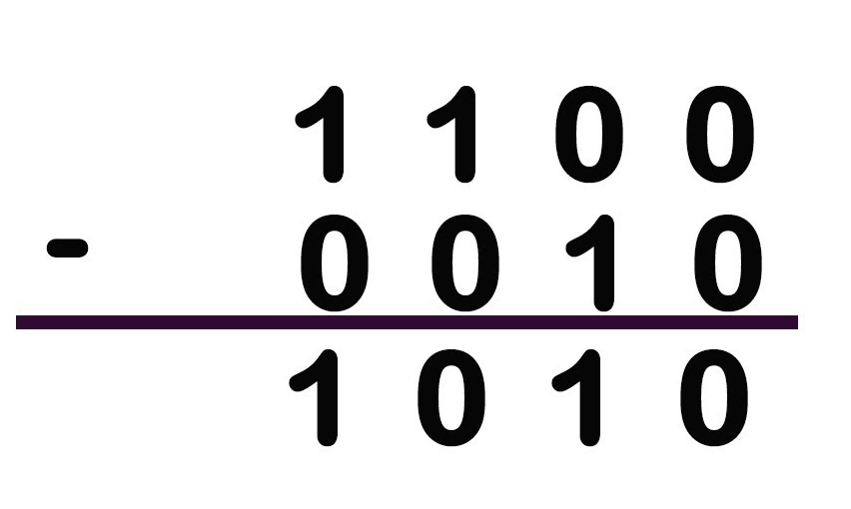
6. Binary Subtraction
  Rules:
  0−0=0
  1−0=1
  1−1=0
  0−1= 1 (with one borrow)
  Example:
  1010 − 0011 = 0111

Slide 25
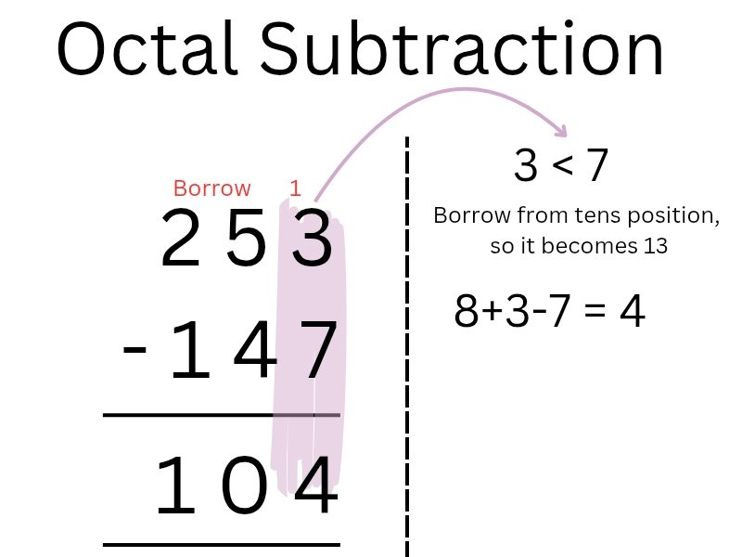
7. Octal Subtraction
  Rules:
  Borrow when digit smaller
  Example:
  25₈ − 7₈ = 16₈

Slide 26
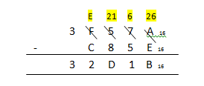
8. Hexadecimal Subtraction
  Rules:
  Borrow when top digit is smaller
  Convert A–F into decimal values when needed
  After subtraction, convert result back to hexadecimal
  Example:
  1A₁₆ − 5₁₆ = 15₁₆

Slide 27
Applications in Computing
1. Data Representation
All data stored in binary (text, images, audio, video)
Example: Character 'A' = 01000001 (ASCII)
2. Memory Addressing
Memory locations written in hexadecimal. Example Address: 0x1A3F
Hex is shorter and easier than binary
3. Machine Language
CPU instructions written in binary
Programmers often read them in hexadecimal form
4. Digital Electronics
Circuits use binary signals. eg: ON = 1, OFF = 0
Used in logic gates and processors

Slide 28
Practice Questions
  Convert 45₁₀ to binary
  Convert 1101₂ to decimal
  Add 1010₂ + 0111₂
  Subtract 1A₁₆ − B₁₆

Slide 29
Summary of Lecture 3
Learned number systems
Learned conversions
Practiced arithmetic operations
Understood computing applications

